Slide 1
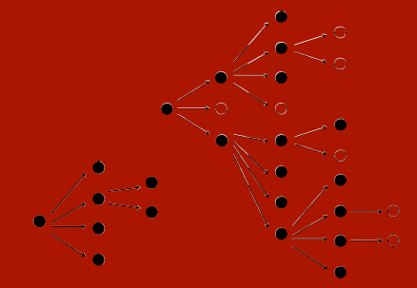
E²M²: Ecological and Epidemiological Modeling in Madagascar
Welcome!
What are we doing here?
January 13 – January 20, 2019
Centre ValBio
Ranomafana National Park, Madagascar

Slide 2



Thanks to our sponsors!

Slide 3
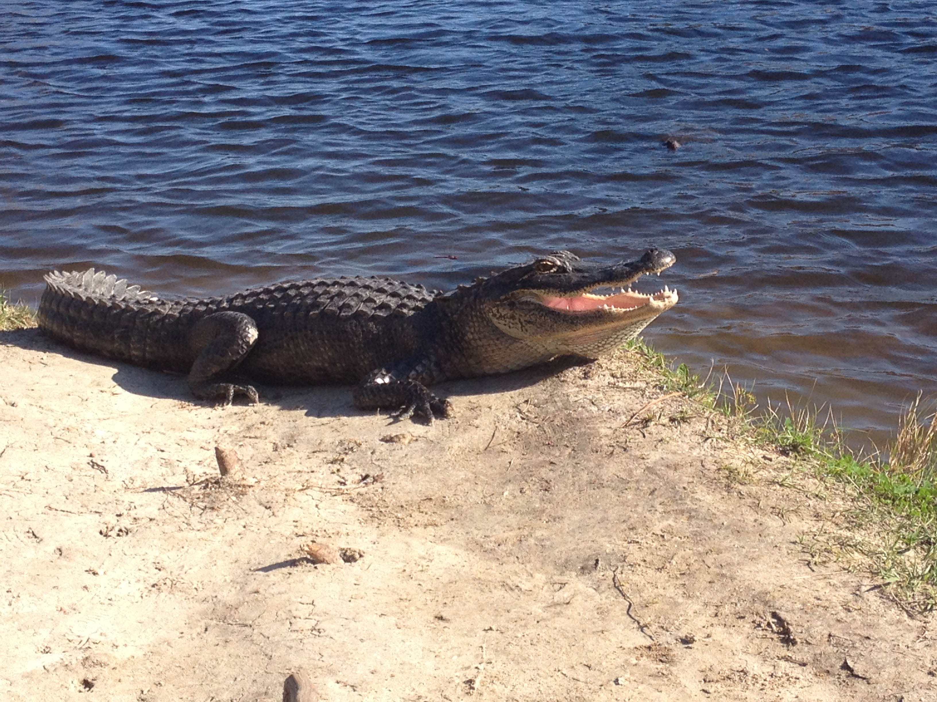

http://www.ici3d.org/
ICI3D: International Clinics on Infectious Disease, Dynamics, and Data
MMED: Clinic on the Meaningful Modeling of Epidemiological Data
May-June 2019, Cape Town, South Africa
DAIDD: Clinic on Dynamical Approaches to Infectious Disease Data
December 2019, Florida, USA
South African Center for Epidemiological Modeling and Analysis (SACEMA), Director
Dr. Juliet Pulliam
University of Stellenbosch
ICI3D, Program Director
Dr. Steve Bellan
University of Georgia

Slide 4
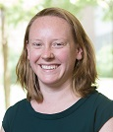

ICI3D: International Clinics on Infectious Disease, Dynamics, and Data
South African Center for Epidemiological Modeling and Analysis (SACEMA), Director
Dr. Juliet Pulliam
University of Stellenbosch
ICI3D, Program Director
Dr. Steve Bellan
University of Georgia

Slide 5
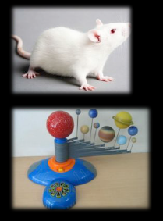
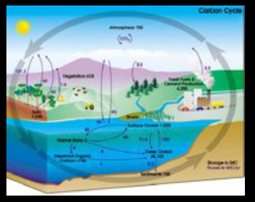
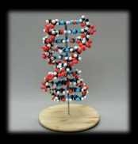
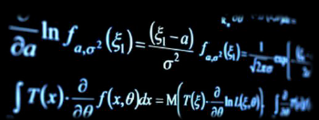
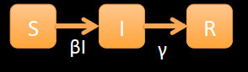
Types of Models
Physical
Conceptual
Mathematical

Slide 6
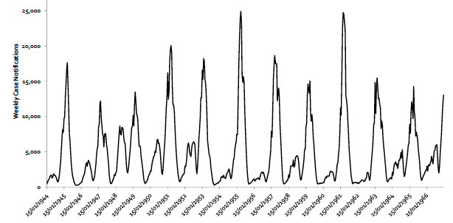
Generally, the idea of the model is to recapitulate the data
Models
Data

Slide 7
Generally, the idea of the model is to recapitulate the data
But, sometimes, data are complex!
Models
Data

Slide 8
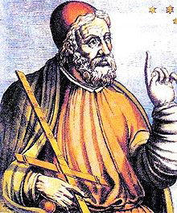
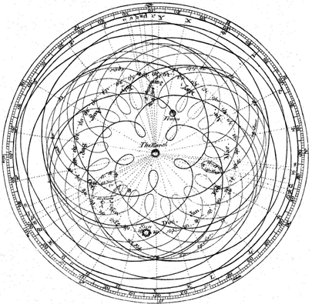
Claudius Ptolemey, AD 90-168
Model:
All planets and moons in the solar system cycle around the Earth (“epicycles”)
Forged data to support his model!

Slide 9
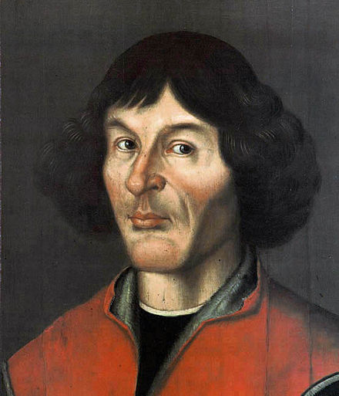
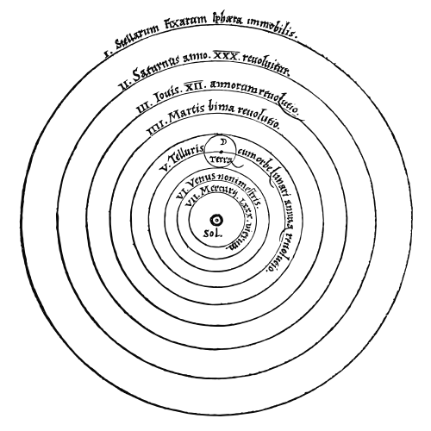
Nicolaus Copernicus, 1473-1543
Model:
All celestial bodies orbit the sun.
But he didn’t have any data!

Slide 10
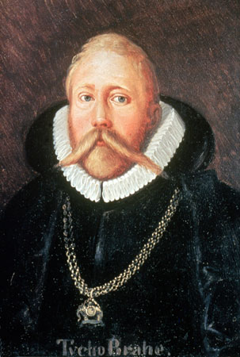
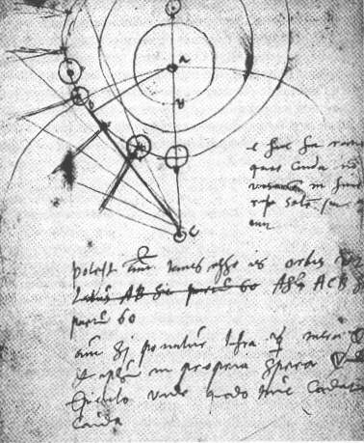
Tycho Brahe, 1546-1601
Collected very a large amount of precise data but still remained loyal to the Ptolemaic model.
Compromised -
Adapted Model:
The sun and the moon orbit the Earth but everything else orbits the sun

Slide 11
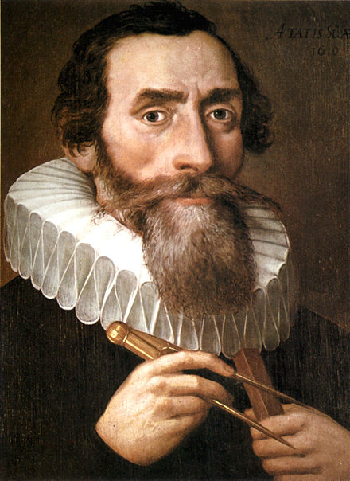
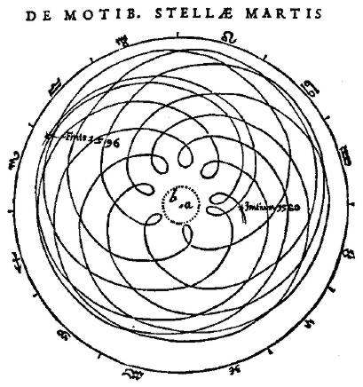
Johannes Kepler, 1571-1630
Used Brahe’s data to fit Copernicus’ model
New Paradigm:
All celestial bodies orbit the sun.

Slide 12
Johannes Kepler, 1571-1630
Used Brahe’s data to fit Copernicus’ model
New Paradigm:
All celestial bodies orbit the sun.
A model becomes paradigm when it is overwhelmingly accepted as fact.

Slide 13

The Utility of Models
“All models are wrong, but some are useful.”
– George Box
We use models to predict, but also to explain.

Slide 14
If we can get the model to recapture the data, then maybe the model can help explain what’s going on in the data
Models
Data

Slide 15
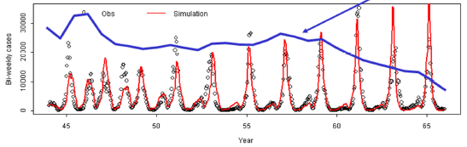
If we can get the model to recapture the data, then maybe the model can help explain what’s going on in the data
Model Fitted to Data

Slide 16
Road Map
schedule and materials live at:
https://carabrook.github.io/E2M2.html

Slide 17
Road Map
Thursday: “Refining Your Work”
● Modeling Extensions: Metapopulation Theory, Including Heterogeneity, etc.
● Intro to Network Modeling
● Intro to Spatial Modeling
● Intro to Network Modeling
● Spatial Modeling & Statistics in R
● Final research plans
● Lectures
● Tutorials/Activities
● Independent Work
Wednesday: “Fitting Models to Data”
● Model Fitting in Practice – the Basic Concept
● Alternative Approaches to Model Fitting
● Epidemic Cards
● Model Fitting with Epidemic Cards
● Model Telephone
Sunday: “Thinking About Data”
● Models and Data
● Linear regression & simple stats
● Exploring and Visualizing Data in R
● Basic statistical modeling in R
● Student introductions & presentations
Friday: “Putting it All in Perspective”
● Model Evaluation and Comparison
● Modeling in Practice: The Lifecycle of a Modeling Project
● Model Selection with Age-Prevalence Data
● Research plan work time
Monday: “Deeper Thinking About Data”
● Intro to Mixed Modeling
● Intro to Occupancy Modeling
● Mixed modeling in R
● Occupancy modeling in R
● Formulating research questions
Tuesday: “Thinking About Mechanism”
● Intro to Compartmental Models & Differential Equations
● Building mechanistic models in R
● Dynamical Fever
● Refining research questions for modeling
● Defining a model world
Monday: “Sharing Your Work”
● Final student presentations

